Slide 1
Introduction to FHIR
HL7 Working Group Meeting
May 2018
Rik Smithies

Slide 2

Instructor
Rik Smithies
Consultant, NProgram Ltd. (UK)
Technical Chair, HL7 UK
HL7 International Co-Chair (Clinical Statement)
HL7 International Standards Governance Board
rik@nprogram.co.uk

Slide 3
This presentation
Can be downloaded here:
https://github.com/FHIR/documents/tree/master/presentations/2018-05%20Tutorials
Is licensed for use under the Creative Commons, specifically:
Creative Commons Attribution 3.0 Unported License
(Do with it as you wish, so long as you give credit)

Slide 4
Acknowledgements
Grahame Grieve
Lloyd McKenzie
Ewout Kramer
David Hay
Josh Mandel
Brett Marquard
et al

Slide 5
Agenda
Introductions
Background to FHIR
Resources: What are they
Terminology
API Exchange: Fetching and Searching for Data
Profiling: Extending beyond the Base Resource
Implementation: Examples
Wrap up

Slide 6
INtroductions

Slide 7

Introductions…
Q1: Are you familiar with FHIR?
Yes
No

Slide 8
Tutorial Objectives
You should:
Know where FHIR fits in the broader healthcare landscape, including other HL7 specifications
Be able to explain what FHIR is to others in your organization, and what impact it might have
Be equipped to help your organization determine if, when, where and how you might use FHIR
Know how to approach the FHIR specification to find out what more you need to know
Be prepared for the more detailed tutorials
Be able to engage with the community
Notes:
I will be trying to use the FHIR specification throughout this tutorial. Try to tie the topic into the spec and where the information can be found. So slides such as the following will be interspersed into the discussion as cues to jump to spec…..
Come back to this at end to see if objectives have been met.

Slide 9
Your Objective…
What’s the single most important thing for you to get out of today’s course?

Slide 10

Background to FHIR

Slide 11
Requirements
Has been a need to share healthcare information electronically for a long time
Increasing pressure to broaden scope of sharing
Across organizations, disciplines, even borders
Mobile, Device & Cloud-based applications
Faster – integration in days or weeks, not months or years
Notes:
Pre-History:
For example v2 is over 25 years old
My personal experience is in Public Health where there is a need to collect information from many organizations.
Currently takes too long and costs too much…

Slide 12
What we have – v2
Works relatively well within institutions
But
Legacy, custom syntax (learning curve, tools)
Messaging design limits architectures
Doesn’t scale well across organization boundaries
Security/privacy infrastructure is minimal
A potpourri of segments and fields with no means to distinguish the common from edge case

Slide 13
What we have – v3
Newer technology and semi-robust reference model, but
Steep learning curve
Primary implementations by those with $$$$s
No inter-version wire compatibility
International specifications are too abstract, regional implementations don’t interoperate

Slide 14
What we have - CDA
Broad implementation, human-to-human interoperability, but:
Still a very steep learning curve
Interoperability beyond a human-to-human level is still a challenge, even with templates
Document architecture doesn’t fit all problems
Still a diversity of implementations
Extensibility is difficult

Slide 15
Complexity Model
Snomed
HL7 V3
openEHR
WS
CDA
Difficulty (log)
XML
How?
HL7 v2
HTTP / HTML
???
Text
Semantic Depth
Notes:
Stole this slide from Lloyd. Because I like it.
Semantic Depth - Knowledge captured in the model.
V2 old, and limited by it’s own rules (though hugely successful)
- V2 version 2 messaging. Pipes and Hats (EDIfact) format – 25 yrs old. Very implementation specific so no two implementations are the same which leads to the need for integration engines to coax interoperability. Doesn’t scale well across organization boundaries
V3 too slow and too hard
- 3-7+ years for a domain to become normative. V3 messaging not widely implemented. Robust modeling but complex and opaque and thus hard to implement. ( for example the content is cluttered with semantic structures )
CDA has success, but both limited and too hard
+ Different contexts of interoperability → different representations that aren’t compatible
Nothing suitable for light-weight integration or for Health 2.0 (WIKIpedia: “While the "2.0" moniker was originally associated with concepts like social networking, collaboration, openness, and participation,^{[5]} in recent years the use of Health 2.0 has migrated to mean the role of SaaS & Cloud-based technologies and their associated applications on multiple devices. Health 2.0 describes the integration of these into much of general clinical and administrative workflow in health care.”
Question is how to get both semantic depth and ease of implementation?

Slide 16
Genesis of FHIR
HL7 undertook a “Fresh look”
What would healthcare exchange look like if we started from scratch using modern approaches?
Web search for success markers led to RESTful based APIs
Exemplar: Highrise (https://github.com/37signals/highrise-api)
Drafted a healthcare exchange API based on this approach
Notes:
What is an (restful) API (Application Programming Interface)? Set of services between machines ( like browsing the web only instead of a human at one end you have 2 machines communicating) In other words an API packages and ships information between places. This can mean if you publish your API you can open up you data and functionality to other developers both internally and externally. For example Amazon API can be used by a third party.
REST (REpresentational State Transfer) is an architectural style RESTful is an implementation based upon REST.

Slide 17
Timeline: Where does FHIR fit?
V2
1987
Start V3
1995
V3
CDA
2005
Fresh
Look
2011
FHIR
STU 3
2017
FHIR
CDA
V3
V2
1980
1990
2000
2010
2018
2020
Notes:
Goal of STU3 in late 2016/early2017

Slide 18
FHIR Timeline (planned)
First Draft
1st
STU
~ 2nd
STU
~ 3rd
STU
R4
. . .
2011
2012
2013
2014
2015
2016
2017
2018
2019
2020
Notes:
Note that dates are subject to change based on resources and the standards process

Slide 19
Who’s working with FHIR?
> 1000 organizations
attended a Connectathon and/or
implementation work in progress
Hard to track who’s doing what
Over 2500 participants on the FHIR Implementer’s chat
http://chat.fhir.org
25+ countries involved so far

Slide 20
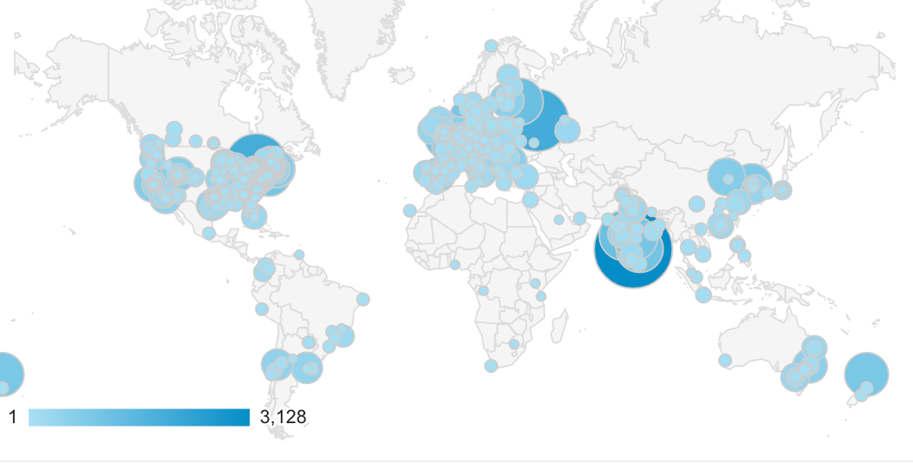
Who’s using FHIR?
Systems accessing HAPI server in previous year (as of 2017-05)
Notes:
Jan->mid Nov. 2015 – unique systems accessing the HAPI test server

Slide 21
The Goals of FHIR
Implementer Focus
Target the 80% (common stuff)
Use today’s web technologies
Support human readability
Paradigm & architecturally agnostic
Open Source

Slide 22
Implementer Focus
Specification is written for one target audience… Implementers
Rationale, modeling approaches, etc. kept elsewhere
Make the resources simple and easy to understand and use
Multiple Implementation tools to help get you started from day 1
Publicly available test servers
Starter APIs published with spec
C#, Java, Pascal, ObjectiveC, Javascript
Lots and lots of examples (and they’re valid too)
Notes:
Specification is written for one target audience: implementers - vs modelers (V3) or clinicians
Rationale, modeling approaches, etc. kept elsewhere - mappings exist more on this later
Resources are simple and easy to understand and use - more on this later
Multiple Implementation tools to help get you started from day 1
Publicly available test servers
Starter APIs published with spec
C#, Java, Pascal, ObjectiveC, Javascript
Lots of examples (and they’re valid too)
Connectathons to verify specification approaches
‘Safe’ extensibility baked in
Who’s read the v3 spec? – modeler & balloter focused
Spec is driven by people who write code for a living
‘Resource’ is the basic building block of FHIR (more on that later)
Numerous pieces have been changed because of experience with what worked when trying to implement
Even have a test workbench for RESTful servers – URL?
External libraries already available
Whole spec is built like software project

Slide 23
Support the 80%
Focus on scenarios that the implementers ask for
Decision to include content into the core specification:
“We only include data elements if we are confident that most normal implementations using that resource will make use of the element” (80% rule)
Other content is included through creation of Profiles and extensions
Notes:
Design by constraint failed – years to develop, what was produced required yet more design to be implementable and after that might not be interoperable
How to determine the 80%? Look to existing specs – v2, v3, CDA templates, OpenEHR, jurisdictional projects, what implementations we’ve seen
If not sure, err on the side of “not in for now”
Note: not 80% of instances, 80% of implementations
Challenges with “raising the bar”
What happens when there aren’t many/any implementations?

Slide 24
Support “Common” Scenarios: Example: FHIR Address (before)
isNotOrdered, updateMode, flavorId, nullFlavor, controlAct root & extension, validTime low and high, useable period (low, high) (GTS – no room on the slide), use
home, primary home, vacation home, workplace, direct, public, bad, physical, postal, temporary, alphabetic, ideographic, syllabic, search, soundex, phonetic, old
0..* parts, each with:text
value, code, code system, code system name, code system version, language, type:
address line, additional locator, unit identifier, unit designator, delivery address line, delivery installation type, delivery installation area, delivery installation qualifier, delivery mode, delivery mode identifier, street address line, building number, building number numeric, building number suffix, street name, street name base, street type, direction, intersection, care of, census tract, country, county or parish, municipalitycity, delimiter, post box, precinct, state or province, postal codezip, delivery point identifier
Notes:
This is what happens when you apply the 80% . . .

Slide 25
Support “Common” Scenarios: Example: FHIR Address
isNotOrdered, updateMode, flavorId, nullFlavor, controlAct root & extension, validTime low and high, useable period (low, high) (GTS – no room on the slide), use
home, primary home, vacation home, workplace, direct, public, bad, physical, postal, temporary, alphabetic, ideographic, syllabic, search, soundex, phonetic, old
0..* parts, each with:text
value, code, code system, code system name, code system version, language, type:
address line, additional locator, unit identifier, unit designator, delivery address line, delivery installation type, delivery installation area, delivery installation qualifier, delivery mode, delivery mode identifier, street address line, building number, building number numeric, building number suffix, street name, street name base, street type, direction, intersection, care of, census tract, country, county or parish, municipalitycity, delimiter, post box, precinct, state or province, postal codezip, delivery point identifier
Notes:
This is what happens when you apply the 80% . . .

Slide 26
Support “Common” Scenarios: Example: FHIR Address
isNotOrdered, updateMode, flavorId, nullFlavor, controlAct root & extension, validTime low and high, useable period (low, high) (GTS – no room on the slide), use
home, primary home, vacation home, workplace, direct, public, bad, physical, postal, temporary, alphabetic, ideographic, syllabic, search, soundex, phonetic, old
0..* parts, each with:text
value, code, code system, code system name, code system version, language, type:
address line, additional locator, unit identifier, unit designator, delivery address line, delivery installation type, delivery installation area, delivery installation qualifier, delivery mode, delivery mode identifier, street address line, building number, building number numeric, building number suffix, street name, street name base, street type, direction, intersection, care of, census tract, country, county or parish, municipalitycity, delimiter, post box, precinct, state or province, postal codezip, delivery point identifier
Notes:
This is what happens when you apply the 80% . . .

Slide 27
Support “Common” Scenarios: Example: FHIR Address (after)
period (low, high)
use
home, work, temp, old
text
line, country, city, state, zip
Notes:
This is what happens when you apply the 80% . . .

Slide 28
Web Technologies
Same technologies that drive Google, Facebook & Twitter
HTTP
DataTypes W3C complaint
XML, JSON, RDF
REST API
HTTPS, OAuth, etc. for security functions
Notes:
We try very hard to *not* invent stuff that exists elsewhere unless it’s really broken or totally unaligned with the FHIR principles.
Atom was used for collection of resources into a bundles - Replaced in DSTU-2 with FHIR bundle
RESTful implementation based upon REST.

Slide 29

Human Readable
In FHIR, every resource should have a human-readable expression
Can be direct rendering or human entered
(Just like CDA)
Notes:
Even when you think your target will understand all the encoded data, reality is data often gets shared beyond the originally intended context
Allow for exceptions for things like automated device readings, etc.

Slide 30

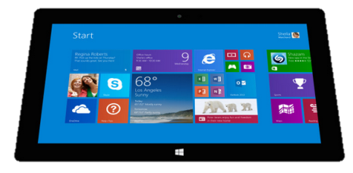
Paradigm Agnostic
The content is the same whatever the interoperability paradigm
Receive a lab result in a message…
FHIR Message
FHIR
Repository
FHIR Document
Lab System
REST
National
Exchange
…Package it in a discharge summary document
…Update a patient record
30

Slide 31

System Architecture Agnostic
FHIR makes no assumptions about the architectural design of systems
Notes:
FHIR makes no assumptions about the architectural design of systems – more on this in another tutorial.
System architecture Jargon words – it still doesn’t matter.
Light or heavy clients
Central server or peer-to-peer sharing
Push or pull
Query or publish/subscribe
Loosely coupled or tightly coupled environments
With history tracking or without

Slide 32
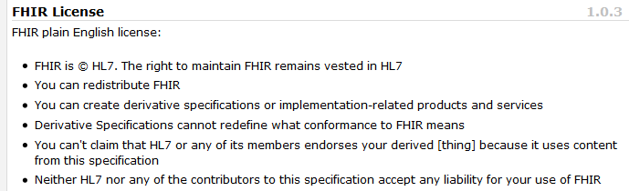
Open Source
Unencumbered – free for use, no membership required
http://hl7.org/fhir
Notes:
Was a bigger deal before HL7 decided to open up all IP
full legal text towards bottom of FHIR home page

Slide 33
Resources: What are they?
The Content model
The Thing that is exchanged
Via REST (FHIR Restful API), Messages, Documents
Informed by much past work inside and outside of HL7
HL7: version 2, version 3 (RIM), CDA
Other SDOs: openEHR, CIMI, ISO 13606, IHE, DICOM
Notes:
vs FHIR REST paradigm - treat data as independently , retrievable resource using http - think of browsing on the web
FHIR RESTful API endpoints on a server and the stuff you can do to get them back
3) FHIR documents/ document paradigm = type of bundle vs CDA Document architecture using FHIR - Clinical document practice - profile on FHIR for CDA on top of that a ccda profile that expresses the dataelements in

Slide 34
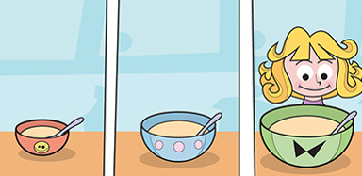
What does a FHIR Resource represent?
Clinical Perspective: The resource content defines a small amount of focused clinical and administrative information
Implementer Perspective: Additional Infrastructural stuff too.
Notes:
Goldilocks analogy - too big – Discharge summary, too small patient sex resource is somewhere in between.

Slide 35
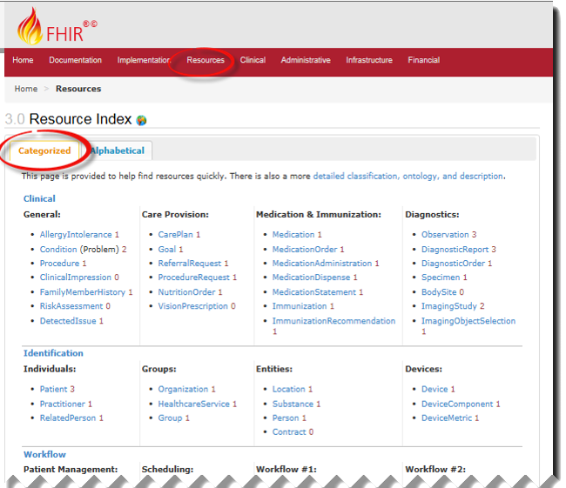
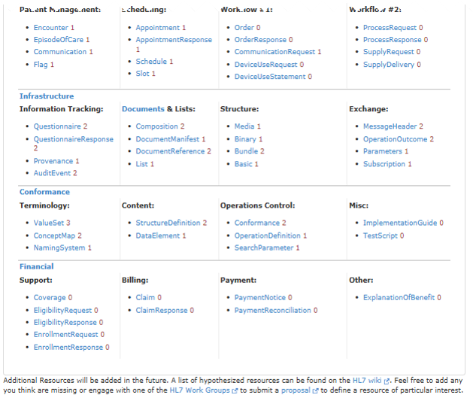
FHIR Resources
Notes:
Examples
Administrative
Patient, Practitioner, Organization, Location, Coverage, Invoice
Clinical Concepts
Allergy, Condition, Family History, Care Plan
Infrastructure
Document, Message, Profile, Conformance
NOT Resources
Gender - datatype
Too small
Electronic Health Record -
Too big
Blood Pressure - Profile
Too specific
Intervention
Too broad
The top 50 (commonly Posted ) resources instances on a sampling of publicly available FHIR Servers. Out of 94
100-150 total - ever

Slide 36
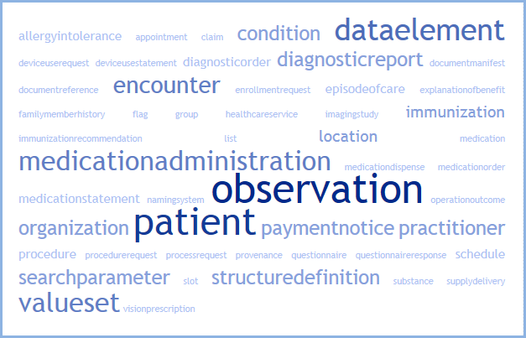
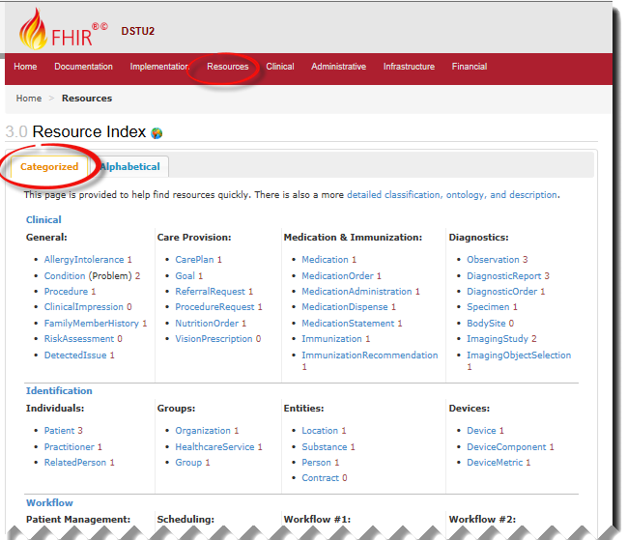
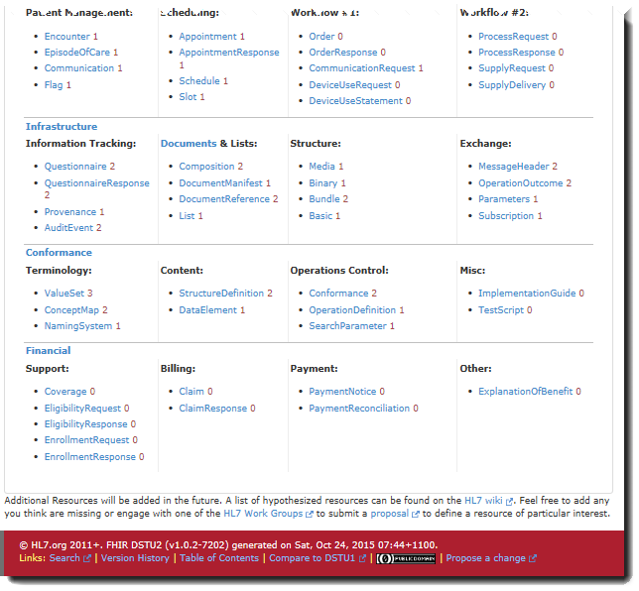
FHIR Resources
Notes:
Examples
Administrative
Patient, Practitioner, Organization, Location, Coverage, Invoice
Clinical Concepts
Allergy, Condition, Family History, Care Plan
Infrastructure
Document, Message, Profile, Conformance
NOT Resources
Gender - datatype
Too small
Electronic Health Record -
Too big
Blood Pressure - Profile
Too specific
Intervention
Too broad
The top 50 (commonly Posted ) resources instances on a sampling of publicly available FHIR Servers. Out of 94
100-150 total - ever

Slide 37
What makes a resource?
Examples
Counter examples
Administrative
Patient, Encounter, Organization, Location
Clinical Concepts
Problem, AllergyIntolerance, Procedure, CarePlan
Medication
Infrastructure
Composition, MessageHeader, CapabilityStatement
Gender – too small
Blood Pressure – too specific (see profiles, terminology)
Electronic Health Record – too big
37
Notes:
Individual resource should be able to “stand alone” they do not conduct information from other resource - through an implied context.
Note on API Exchange- the FHIR API defines that a given relative endpoint must always behave the same way. Like copying your file system on your hard drive to everybody else … is always going to be the same. So /Patient exists on every FHIR servers ( that supports Patient) and that is where the patient resources is stored.
See example resource Snippet in XML
Same in JSON
"patient": {
"reference": "Patient/example",
"display": "Peter Chalmers"
},
"orderer": {
"reference": "Practitioner/example",
"display": "Dr Adam Careful“
},
Other referencing rules
References can be relative or absolute
References don’t have to be to the same server
Server does not have to enforce integrity
Clients need to cater for broken links
Targets can be ‘contained’ in the resource:

Slide 38
Connecting Resources
Resources are independent – don’t need other resources to correctly interpret a resource
But a single resource doesn't say very much, but a collection of resources taken together creates a useful clinical record.
38
Notes:
Individual resource should be able to “stand alone” they do not conduct information from other resource - through an implied context.
Note on API Exchange- the FHIR API defines that a given relative endpoint must always behave the same way. Like copying your file system on your hard drive to everybody else … is always going to be the same. So /Patient exists on every FHIR servers ( that supports Patient) and that is where the patient resources is stored.
See example resource Snippet in XML
Same in JSON
"patient": {
"reference": "Patient/example",
"display": "Peter Chalmers"
},
"orderer": {
"reference": "Practitioner/example",
"display": "Dr Adam Careful“
},
Other referencing rules
References can be relative or absolute
References don’t have to be to the same server
Server does not have to enforce integrity
Clients need to cater for broken links
Targets can be ‘contained’ in the resource:

Slide 39
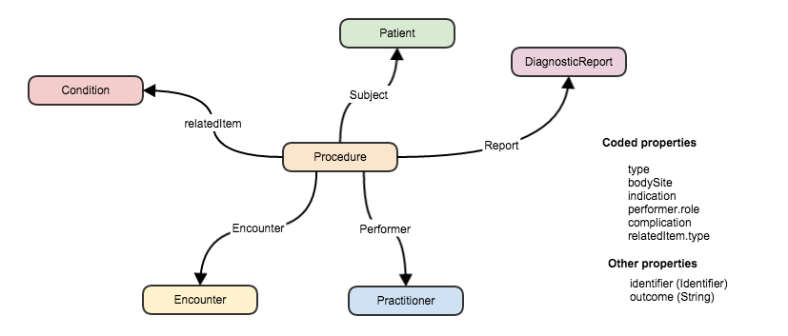
Connecting Resources
FHIR resource
“container” of information that represent something in the real world
Link between resources
Notes:
Can create a ‘network’ of interrelated resources through referencing rather than sending all the data. By resources referencing each other extensively they form a web of information.

Slide 40
Taking a tour of a FHIR Resource
Scope and Usage Notes
Resource Content (UML and XML)
Terminology Bindings
Constraints
Implementation Issues
Search Parameters
Examples, Profiles, Formal Definitions
Mappings to RIM, CDA, v2, etc
Notes:
View a resource in more detail…
Show in spec how get to any resource in 2 clicks

Slide 41
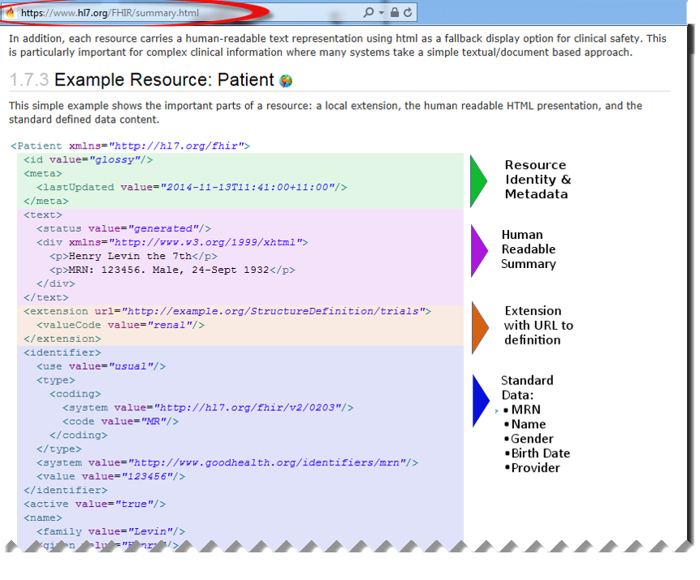
Anatomy of a Resource
Notes:
Focus on the Resource Content Defined Structured Data
The logical, common contents of the resource
Each Resource is composed of about 20-40 resource elements example instances to follow
Mapped to formal definitions/RIM & other formats ( need a screen shot of this)
Extensions
“Non-common” requirements, but everyone can use
Published and managed
Narrative
Human readable (fall back)
Metadata including the resource id ( how to find it on or refer to it) tags, history/versioning

Slide 42
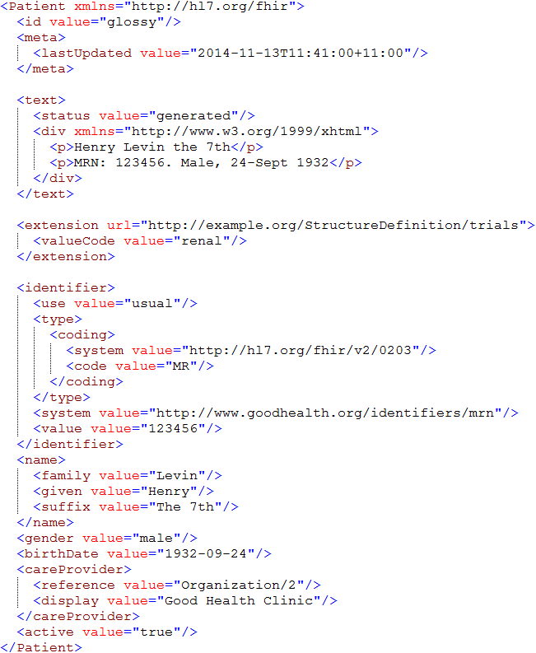
Identity & Metadata
Human Readable Summary
Extension with reference to its definition
Standard Data Content:
MRN
Name
Gender
Date of Birth
Provider

Slide 43
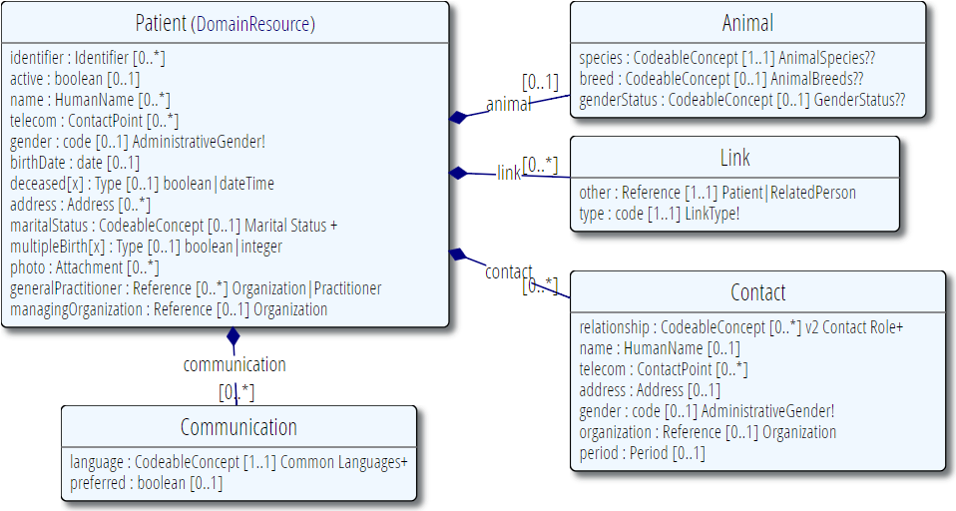
Resource Definitions

Slide 44
Resource Elements
Each Resource is composed of about 20-40 resource “elements”
Each resource element is defined by:
Name
Cardinality
Type (Data type or structural resource)
Description
Terminology Binding
Other stuff (Comments, Constraints, Summary Flags, mappings, etc.)
Notes:
Each Resource is composed of resource elements. These element can be structural or define a particular Data element.

Slide 45
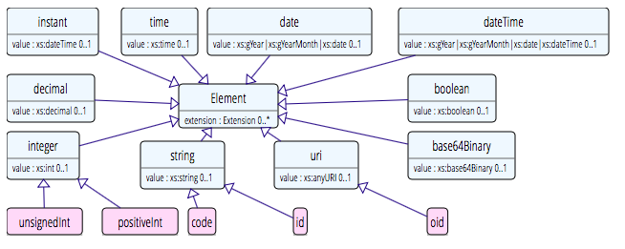
Data types: Primitive
Based on w3c schema and ISO data types
Simplified – Stick to the “80% rule” – only expose what most will use

Slide 46
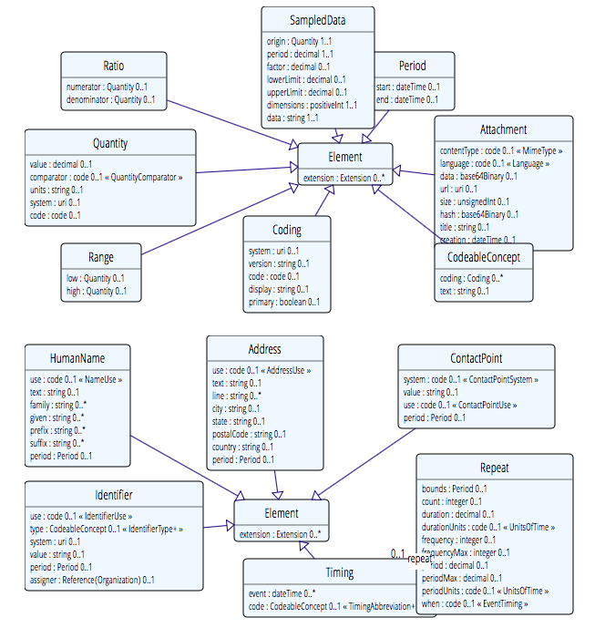
Complex
Notes:
Complex meaning composed of other datatypes - example identifier, CodeableConcept. Rik – this is a little out of date for STU3 but not hugely and the older version fits better on the slide.

Slide 47

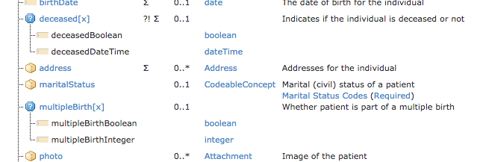
Polymorphic Properties
Where a property can have different datatypes
Can use a profile to restrict to specific type
To come!

Slide 48
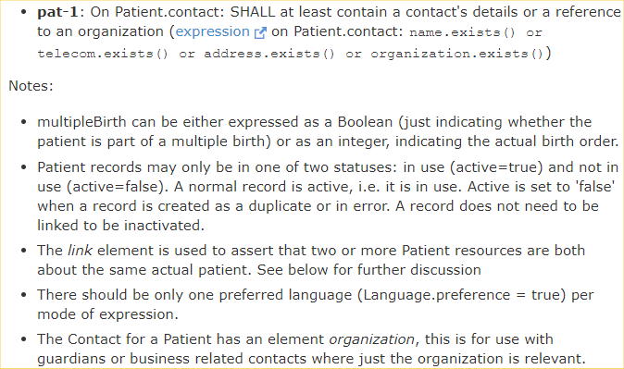
Constraints & Notes

Slide 49
Resource Identifiers
2 different ‘sorts’ of identity
ID identifies a resource on a (REST) server
Is Metadata
Will change between servers
Identifier
Business identifier
Is an element in the (core) resource
Notes:
See example of business identifier

Slide 50
A Resource’s ID
http://server.org/fhir/Patient/1
resource type
endpoint
id
Note: This URL resolves to the current version of a resource
It’s also specific to a server
Notes:
This is not only the URL you use to retrieve the resource, it’s also its id.
All URL’s in FHIR are case-sensitive (and so is the id)

Slide 51
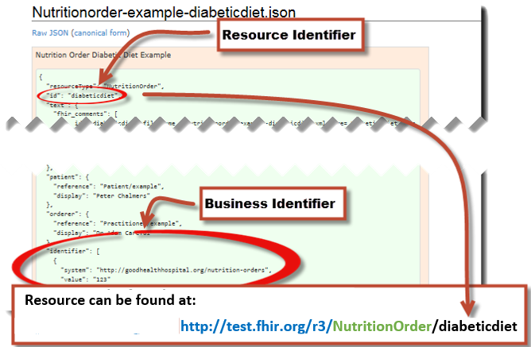
A Resource’s ID Example
Notes:
This is not only the URL you use to retrieve the resource, it’s also its id.
All URL’s in FHIR are case-sensitive (and so is the id)

Slide 52
Narrative
Notes:
Narrative
Human readable (fall back)
All resources can carry an html representation of their content
It’s a clinical safety issue
The receiver has a fall back option if the system is not sure it fully understands the content
It is not mandatory, but SHOULD be present
In a closed eco-system, with extremely tight control and strong conformance testing, it may not be necessary
But things often change over time
So using narrative is highly recommended

Slide 53
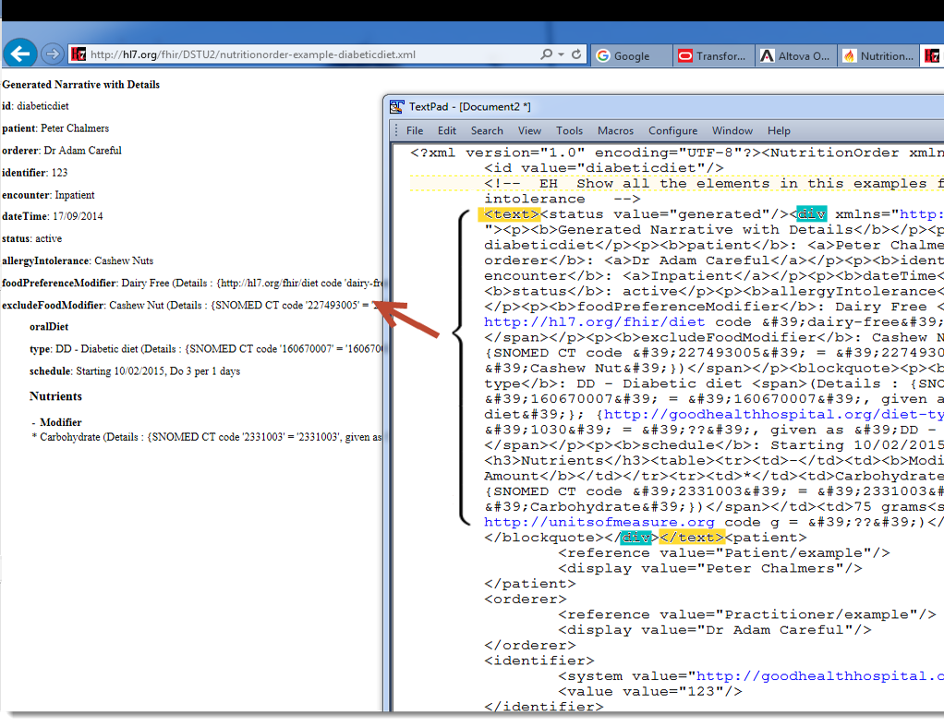
Narrative example
Notes:
Resources SHOULD always contain narrative to support human-consumption as a fallback. However, in a strictly managed trading systems where all systems share a common data model and additional text is unnecessary or even a clinical safety risk, the narrative may be omitted.
generated The contents of the narrative are entirely generated from the structured data in the resource.
extensions The contents of the narrative are entirely generated from the structured data in the resource and some of the content is generated from extensions.
additional The contents of the narrative contain additional information not found in the structured data.
empty the contents of the narrative are some equivalent of "No human-readable text provided for this resource".

Slide 54

Terminology

Slide 55
Examples of Coded Data in FHIR
Code Datatype
e.g. Patient gender = “male”
CodeableConcept Datatype
e.g. Observation code for a Blood Glucose measurement: LOINC = “2339-0” (Glucose [Mass/volume] in Blood) Displayed as Glucose, Blood
Quantity Datatype
Units of measure for the Blood Glucose measurement:
80 UCUM units = mg/dL

Slide 56
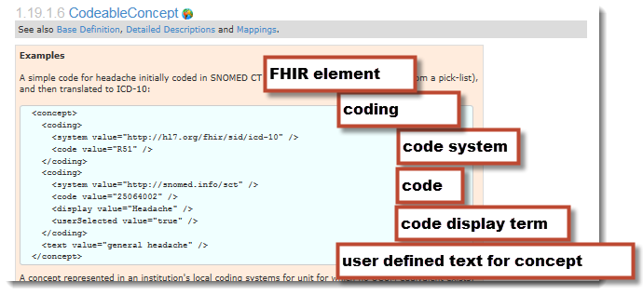
CodeableConcept: Example
(2 of)
Notes:
Example instance in XML: and general pattern for coded data.

Slide 57
Examples
Code: "status" : "confirmed"
Coding: { "system": "http://www.nlm.nih.gov/research/umls/rxnorm", "code": "C3214954", "display": "cashew nut allergenic extract Injectable" }
CodeableConcept: { "coding": [{ "system": "http://snomed.info/sct", "code": "39579001", "display": "Anaphylactic reaction“ }], "text" : "Anaphylaxis" }

Slide 58
Code Systems
Code System:
Defines a set of concepts with a coherent meaning Code Display
Definition
SNOMED CT / LOINC / RxNORM
HGVS, ICPC, MIMS + 100s more
ICD-X+
ANZSCO, METEOR
A drug formulary
A config table in an application
A list of enums in a java class
Australian state codes

Slide 59
Value Sets
Code System:
Defines a set of concepts with a coherent meaning Code Display
Definition
Value Set:
A selection of a set of codes for use in a particular context
Selects from one or more
Notes:
E.g. condition with different specialties

Slide 60
Bindings
Code System:
Defines a set of concepts with a coherent meaning Code Display
Definition
Value Set:
A selection of a set of codes for use in a particular context
a FHIR Coded Element
Binds
Selects from one or more

Slide 61
Binding Strength
How closely the options in the value set should be followed
Values
Required (must come from set)
Extensible (may use alternate if have to)
Preferred (don’t have to, but should)
Example (set isn’t specified)
Can use a profile to vary
Make stronger not weaker

Slide 62
ValueSet resource
Defines list of possible values for a particular context
Can reference external Terminology/s
Or define own sets
Why?
A common ValueSet improves recording consistency
Improves user experience (pick lists)
Examples in New Zealand
ED diagnoses (derived from SNOMED)
NZ POCS (Pathology Observation Code Set) (derived from LOINC)
List of NZ “Iwi” (defined in ValueSet – iwi is a nation or tribe)

Slide 63




Terminology Server
Provides ‘services’ for consumers to access terminology
Hide the complex stuff from a consumer
Uses Operations framework
Get definition for a concept
Find a concept
Within a ValueSet
Find Terms
Get Term Definition
http://hl7.org/implement/standards/fhir/terminology-service.html
Notes:
Expand
http://fhir-dev.healthintersections.com.au/open/ValueSet/valueset-condition-code/$expand?filter=diabetes
Lookup
http://fhir-dev.healthintersections.com.au/open/ValueSet/$lookup?system=http://loinc.org&code=8480-6

Slide 64
FHIR and REST

Slide 65
REST: a URL based API
http://server.org/fhir/Patient/1
resource type
endpoint
id
Note: This URL resolves to the current version of a resource
It’s also specific to a server
Notes:
This is not only the URL you use to retrieve the resource, it’s also its id.
All URL’s in FHIR are case-sensitive (and so is the id)

Slide 66
REST: JSON
http://server.org/fhir/Patient/1?_format=json
resource type
endpoint
id
command
Gets the same patient but returns as JSON instead
Notes:
This is not only the URL you use to retrieve the resource, it’s also its id.
All URL’s in FHIR are case-sensitive (and so is the id)

Slide 67
REST: Search
http://server.org/fhir/Patient?name=Smith
resource type
endpoint
search term
Note – no ID specified
Notes:
This is not only the URL you use to retrieve the resource, it’s also its id.
All URL’s in FHIR are case-sensitive (and so is the id)

Slide 68
REST in practice
“Resources” with an explicit and stable URI
The name for what gets exchanged in REST
Defined behaviour and meaning
Known identity / location
Quite an abstract idea
Formats: XML / JSON / RDF
Exchange using HTTP
Security: SSL / OAuth
Notes:
FHIR Resources are a representation of “something” in healthcare

Slide 69
REST actions
CRUD:
Create – create a new instance of data
HTTP POST
Read – get the content (state) of an instance of data
HTTP GET
Update – change the content of an instance of data
HTTP PUT
Delete – remove the instance of data
HTTP DELETE
Notes:
Delete isn’t necessarily physical
Execute – e.g. transaction

Slide 70
FHIR reuses these
Instance
Read GET [base]/Patient/100
Update PUT [base]/Patient/100
Delete DELETE [base]/Patient/100
History GET [base]/Patient/100/_history
Vread GET [base]/Patient/100/_history/{vid}
Type
Create POST [base]/Patient
Search GET [base]/Patient?name=eve
History GET [base]/Patient/_history
Validate POST [base]/Patient/$validate
System
Conformance GET [base]/metadata
Transaction POST bundle to root
History GET [base]/_history
Details see: http://hl7.org/implement/standards/fhir/http.html
Notes:
Basic syntax for each Restful transaction.
base is server endpoint.
If >1 then wrapped in a bundle resource.
Can specify format by using _format parameter or headers for XML/JSON
Examples:

Slide 71
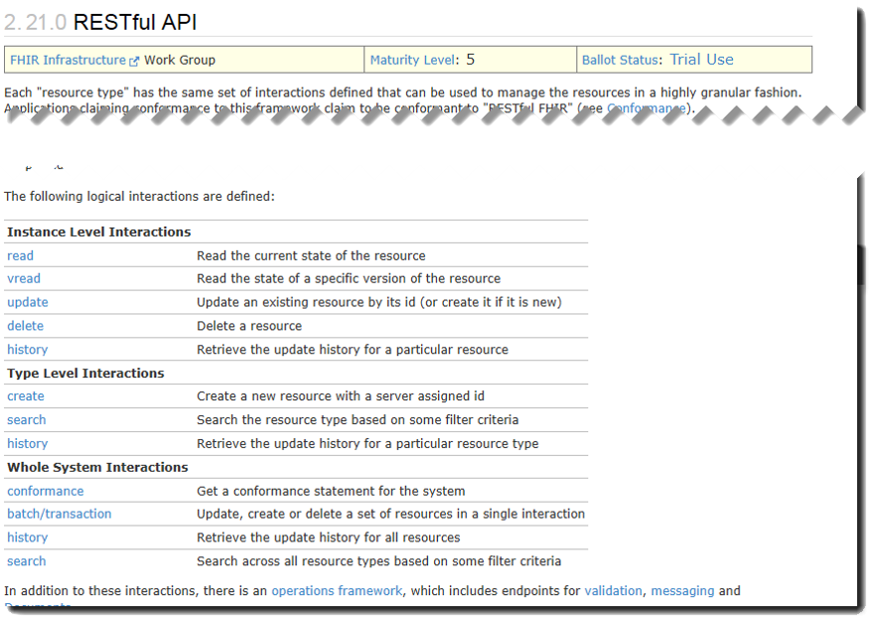
FHIR RESTful Interactions
http://hl7.org/implement/standards/fhir/http.html
Notes:
Description of interactions
If >1 then wrapped in a bundle resource.
Can specify format by using _format parameter or headers for XML/JSON
Examples:

Slide 72
FHIR RESTful Search
Works on pre-defined named parameters (only) (e.g. “name”)
Listed at the end of each resource
GET [base]/Patient?name=eve
GET [base]/Observation?code=3141-9
GET [base]/Patient/100
GET [base]/Patient?_id=100
GET [base]/Patient?identifier=MRN1234
Note that the 3rd one is actually the odd one out here – why?
Notes:
Answer is that the 3rd one is not actually a search (and doesn’t return a Bundle). It is just a direct read. To search by id you use the “_id” parameter
Use browser for simple searches. Pull up a Argo Wiki
Sample CRUD stuff using Curl, Fiddler or PostMan or pull up Wiki
e.g.
GET
>curl http://fhirtest.uhn.ca/baseDstu2/Patient/1
Add –I option to display headers for transaction response (e.g. 200, 201)
>curl –i http://fhirtest.uhn.ca/baseDstu2/Patient/1
History
>curl http://fhirtest.uhn.ca/baseDstu2/Patient/1_history
Create (RESTful HTTP POST)
curl -d @filename --header "Content-Type: text/xml“ http://hostname/resource (--header "Content-Type: text/json“ )
>curl –i –X POST --header "Content-Type: text/xml“ -d @file.xml http://fhirtest.uhn.ca/baseDstu2/Observation
Update /Create (RESTful HTTP PUT)
curl --upload-file filename --header "Content-Type: text/json“ http://hostname/resource/id
>curl –X PUT --header "Content-Type: application/json“ –d @file.json http://fhirtest.uhn.ca/baseDstu2/Patient/example
Search for Observation(s) with LOINC code
GET [base]/Observation?code=[LOINC]
>curl –i http://fhirtest.uhn.ca/baseDstu2/Observation/?code=3141-9
.
Search for patient on name
Specify json or xml
Get a patient
Update a patient
Grahames & Ewouts server

Slide 73
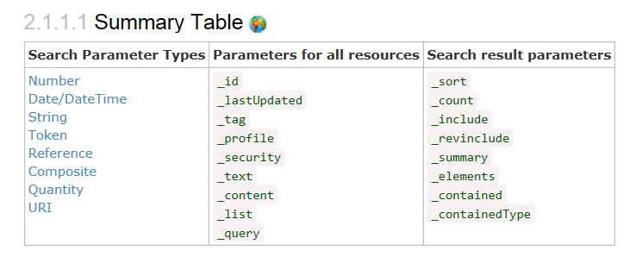
FHIR RESTful Search
Notes:
Searching for resources is fundamental to the mechanics of FHIR.
Search operations traverse through an existing set of resources filtering by parameters supplied to the search operation.
In the simplest case, a search is executed by performing a GET operation in the RESTful framework: Functionally, this is equivalent to a simple read operation:
Each search parameter is defined by a type that specifies how the search parameter behaves. These are the defined parameter types:
Number Search parameter SHALL be a number (a whole number, or a decimal).
Date Search parameter is on a date/time. The date format is the standard XML format, though other formats may be supported.
String Search parameter is a simple string, like a name part. Search is case-insensitive and accent-insensitive. May match just the start of a string. String parameters may contain spaces.
Token Search parameter on a coded element or identifier. May be used to search through the text, displayname, code and code/codesystem (for codes) and label, system and key (for identifier). Its value is either a string or a pair of namespace and value, separated by a "|", depending on the modifier used.
[parameter]=[code]: the value of [code] matches a Coding.code or Identifier.value irrespective of the value of the system property
Reference A reference to another resource.
Composite A composite search parameter that combines a search on two values together.
Quantity A search parameter that searches on a quantity.
Uri A search parameter that searches on a URI (RFC 3986).

Slide 74
Miscellaneous Topics
Versioning and History
Bundles
Contained Resources

Slide 75
Versioning
Most recent version
http://server.org/fhir/Patient/1
Returns single resource
All versions
http://server.org/fhir/Patient/1/_history
Returns bundle of versions (see later)
Specific version
http://server.org/fhir/Patient/1/_history/1
Returns single resource
Version support is optional
Notes:
Works at instance and type level – originally there

Slide 76
Version history – and revival
33, v13 – 2012-12-05
/server.org/fhir/Patient/33/_history/13
33, v14 – 2012-12-08
/server.org/fhir/Patient/33/_history/14
33, v15 – 2012-12-09
/server.org/fhir/Patient/33/_history/15
33, v16 – 2012-12-10
/server.org/fhir/Patient/33/_history/16 (gets deleted)
33, v17 – 2012-12-11
/server.org/fhir/Patient/33/_history/17
PUT /server.org/fhir/Patient/33
Notes:
* The resource returns back to life!

Slide 77
Bundles
Bundle is a FHIR resource – for containing other resources
When more than one resource needed
Query result
Document
Message
Transaction
A technical grouping rather than a logical one
no inherent business meaning in the grouping, unlike the List resource

Slide 78
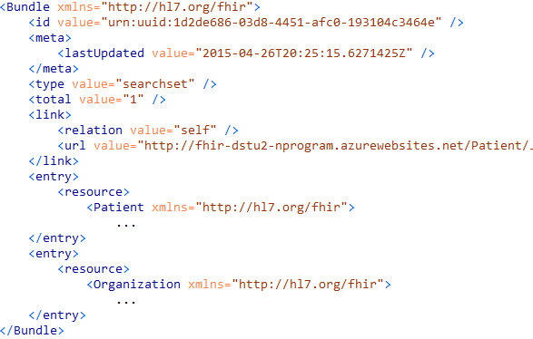
Query response

Slide 79
Transactions / Batches
Multiple operations at once
Transaction
Related resources - Referential integrity
Batch
Unrelated
Return bundle with outcomes

Slide 80
Paradigms
FHIR supports 4 interoperability paradigms
REST
Documents
Messages
Services

Slide 81
Documents – are bundles
Composition Resource
<Bundle>
<entry>
<Composition />
</entry>
<entry>
<Observation />
</entry>
<entry>
<Device />
</entry>
<entry>
<List/>
</entry>
<entry>
<Condition/>
</entry>
</Bundle>
Metadata
Attester
Section
Section
Section
Observation Resource
Device Resource
List Resource
Condition Resource
Notes:
A Document, no matter how nested, is flattened to a list of entries, the Document’s header being the first.
The document header (and any other the other resources) refer to each other using normal references to reflect the document’s nesting.
Of course, there may be a digital signature (on the whole Bundle) to attest to the content of the document.

Slide 82
Miscellaneous Topics
Tags
Versioning and History
Bundles
Contained Resources

Slide 83
Tags
Contain metadata about resources
Beyond ID, version & date
Used for different purposes:
Compliance to Profile
Security – e.g. sensitivity of resource
User defined
Transported in different ways:
REST – as an HTTP header
In a bundle (document, message, transaction) - in the metadata element of the resource or the bundle
Notes:
Indicate Document/Message removed as bullet since no longer true.

Slide 84
Contained Resources
When there is no external identity
Has limitations
No reuse
Very hard to ‘resolve’ to ‘real’
Use when you have to
Notes:
Show my site as a demo http://nprogram.azurewebsites.net/DiagnosticReport/1 vs. /10

Slide 85
Operations
The RPC of REST
Uses syntax: $operation
Examples in spec
Get Patient record (base]/Patient/[id]/$everything)
Expand ValueSet ([base]/ValueSet/$expand)
Fetch Encounter’s related data ([base]/Encounter/[id]/$everything)
Uses Parameter resources to define Inputs & Outputs
http://hl7.org/implement/standards/fhir/operations.html

Slide 86
RPC vs REST example
Example:
A device that monitors a patient %0₂ Sat
Raises an alarm on EHR if it’s too low
EHR can turn the alarm off
RPC:
POST http://acme.org/devices/turnOffAlarm
Parameters: device id, alarm id
REST (not FHIR):
POST http://acme.org/devices/[deviceid]/[alarmid]
Content: data to say “Alarm is off”

Slide 87
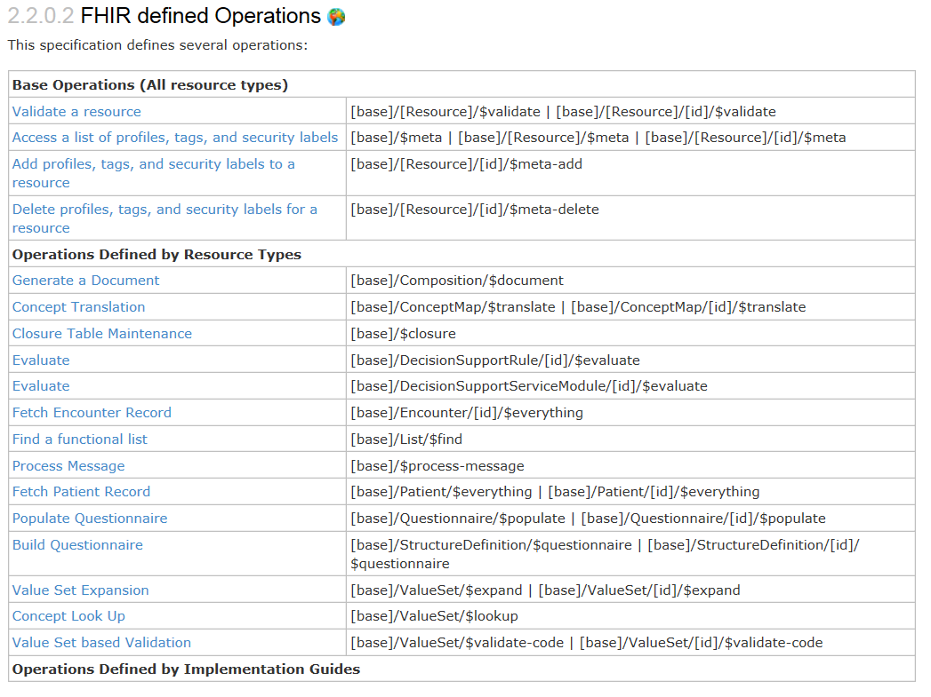
FHIR Operations

Slide 88
FHIR Profiles
Many different contexts in healthcare, but a single set of Resources
Need to be able to describe restrictions based on use and context
Allow for these usage statements to be:
Authored in a structured manner
Published in a repository
Used as the basis for validation, code, report and UI generation.
Profiling is going to be very important!

Slide 89
The need for Profiles
Profiles can serve the same purpose as:
CDA templates & implementation guides
HL7 v2 “static” profiles
CIMI implementation guides
OpenEHR Archetypes & templates
Profiles aren’t mandatory for interoperability, but they improve the degree of it
Profiles never change meaning of an instance

Slide 90
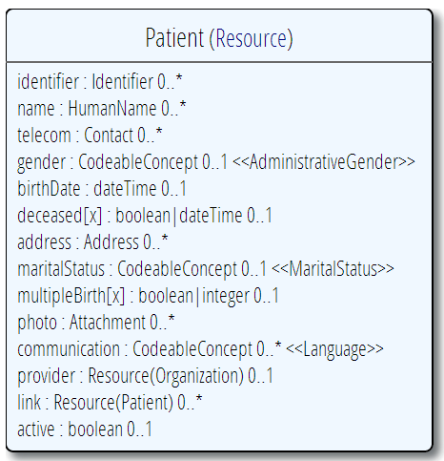
Profiling a resource. For example...
Require that the identifier uses the NHI – and is required
Limit names to just 1 (instead of 0..*)
Limit maritalStatus to another set of codes that extends the one from HL7 international
Add an extension to support “iwi” (NZ example)
Constrain out animal element (card. => 0..0)
Notes:
Note: hardly any mandatory elements in the core spec!
Tools for creating profile being develop - Forge..

Slide 91
Extensions
FHIR has a standard framework for extensions
Built into the “wire format”
Every FHIR element can be extended
Including datatypes
Every extension has:
url – reference to a computable definition
value – the actual data (typed from a set of known types)
Every system can read, write, store and exchange all legal extensions – because they are all in one format
All extensions are valid by schema etc.
Notes:
In FHIR, extensions are “normal”
Consequence of the 80% rule – keep the simple stuff simple
Extensions can exist anywhere
Resource, Element, DataType
Conformant systems can’t reject instances just because they contain unrecognized extensions
They could:
Display them
Should be in resource narrative
Store as a ‘Blob’
Make a conscious decision to ignore (unless ModifierExtension)
(Could lookup profile)

Slide 92
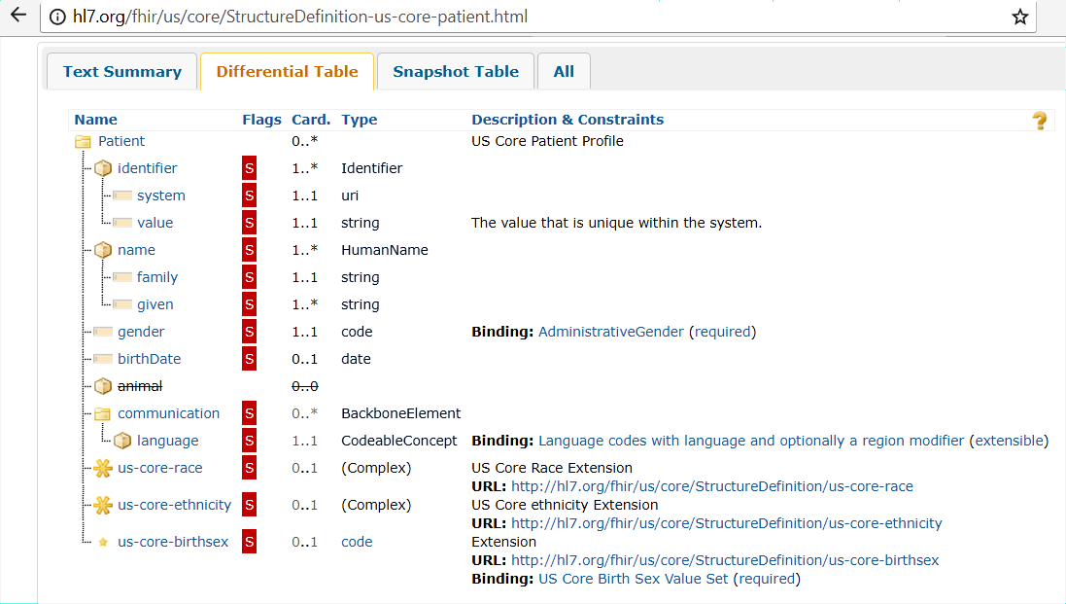
Extension Example
Notes:
US required race and ethnicity for patient. (note this is logical view of DAF Patient profile)
Other extensions as well

Slide 93
How does FHIR compare?

Slide 94
V2 and FHIR
Similarities
FHIR Differences
Built around re-usable “chunks” of data
Strong forward/backward compatibility rules
Extensibility mechanism
Each chunk (resource) is independently addressable
More than messages
Human readable required
Extensions don’t collide, are discoverable
Modern tools/skills
Instances easy to read
Lighter spec
Notes:
Many interface engine vendors working on FHIR support
May make sense for internals of some v2 systems
Add-on interface for mobile, personal health record

Slide 95
V3 and FHIR
Similarities
FHIR Differences
Based on RIM, vocab & ISO Data types foundations
Support XML syntax
Simpler models & syntax (reference model hidden)
Friendly names
Extensibility with discovery
Easy inter-version wire compatibility
Messages, documents, etc. use same syntax
JSON syntax too
Notes:
Lower learning curve
Unlikely to see significant new v3 initiatives in areas that aren’t already committed to it

Slide 96
FHIR and CDA
Similarities
FHIR Differences
Support profiling for specific use-cases
Human readability is minimum for interoperability
APIs, validation tooling, profile tooling
(See v3 similarities on prior slide)
Initial discrete interoperability with the base specification (no templates)
Not restricted to just documents
Implementer tooling generated with spec
(See v3 differences on prior slide)
Notes:
Significant work on CCDA <-> FHIR
Can use both FHIR and CCDA documents with XDS and with MHD

Slide 97
FHIR and Services
Similarities
FHIR differences
Encourage context neutral, re-usable structures with defined behavior
RESTful interface is a simple SOA interface
Consistent data structures across services
Ease of transport across paradigms message <-> service <-> document <-> REST
Standard framework for defining/discovering services
Notes:
FHIR allows defining simple services via the “OperationDefinition” mechanism as well as custom services.
E.g. Value set expansion, code translations – full terminology services

Slide 98
So why use anything else?
FHIR is brand new
Minimal market share
Not yet normative
Limited track record
Business case
No-one dumps existing working systems just because something new is “better”
Most Large projects committed to one standard won’t change direction quickly (or even at all)

Slide 99
FHIR as a replacement
Yes, FHIR has the potential to supplant HL7 v3, CDA and even v2
However
It’s probably not going to do so right away
HL7 will support existing product lines so long as the market needs them
Notes:
Few will throw away their investment in older standards to use FHIR until
The specification has a good track record
It’s clear the new thing provides significant benefits

Slide 100
Implementing FHIR

Slide 101
FHIR - Getting started
Access public server using
Browser can be used for Read interactions
Clickable demo at fhirtest.com
Developer Tools to Create and Update
Curl – command line tool
Fiddler, Postman and other applications
ClinFHIR, NotePad++ Plugin
Applications
Smart Clients
Notes:
Use browser for simple searches. Pull up a Argo Wiki
Sample CRUD stuff using Curl, Fiddler or PostMan or pull up Wiki
e.g.
GET
>curl http://fhirtest.uhn.ca/baseDstu2/Patient/1
Add –I option to display headers for transaction response (e.g. 200, 201)
>curl –i http://fhirtest.uhn.ca/baseDstu2/Patient/1
History
>curl http://fhirtest.uhn.ca/baseDstu2/Patient/1_history
Create (RESTful HTTP POST)
curl -d @filename --header "Content-Type: text/xml“ http://hostname/resource (--header "Content-Type: text/json“ )
>curl –i –X POST --header "Content-Type: text/xml“ -d @file.xml http://fhirtest.uhn.ca/baseDstu2/Observation
Update /Create (RESTful HTTP PUT)
curl --upload-file filename --header "Content-Type: text/json“ http://hostname/resource/id
>curl –X PUT --header "Content-Type: application/json“ –d @file.json http://fhirtest.uhn.ca/baseDstu2/Patient/example
Search for Observation(s) with LOINC code
GET [base]/Observation?code=[LOINC]
>curl –i http://fhirtest.uhn.ca/baseDstu2/Observation/?code=3141-9
.
Search for patient on name
Specify json or xml
Get a patient
Update a patient
Grahames & Ewouts server

Slide 102
Tools to Visualize FHIR resources
(David Hay’s) clinFHIR tool
http://clinfhir.com/
Educational tool
For non-techies (especially clinicians & BA)
Beta software!
Resource Builder
View Resources
Create Condition
Notes:
FHIR Notepad++ Plugin: http://www.healthintersections.com.au/FhirServer/fhirnpp.htm
ClinFHIR : http://clinfhir.com/
Demo here We are going to use this today. Maybe also with Notepad plugin as well.

Slide 103
Tools to Visualize FHIR resources
TextEditor
Notepad++
FHIR Plugin (http://www.healthintersections.com.au/FhirServer/fhirnpp.htm)
Atom, etc.
XML/JSON editors
XMLSpy, Oxygen etc.
Notes:
FHIR Notepad++ Plugin: http://www.healthintersections.com.au/FhirServer/fhirnpp.htm
ClinFHIR : http://clinfhir.com/
Demo here We are going to use this today. Maybe also with Notepad plugin as well.

Slide 104
Where can FHIR be used?
Classic in-institution interoperability
Back-end e-business systems (e.g. financial)
Regional Health Information Organizations (RHIO)
National EHR systems
Social Web (Health)
Mobile Applications

Slide 105
Architecture
Standalone FHIR Server
A FHIR Server in front of an existing application (e.g. SQL)
An interface engine that ‘speaks’ FHIR
A tablet/mobile phone application
Web portal uses FHIR to access other systems
A healthcare application that access information from multiple systems as well as it’s own server
Smart-On-FHIR – an EHR plug-in framework
105

Slide 106
Implementation Tools
Reference Implementations – object models, parsers, serializers, clients, validators, utilities
Schema, Schematron, Validation Pack
1000s of examples
106
Notes:
FHIRpath -

Slide 107
Test Servers
Use the servers to explore how it works
wiki.hl7.org/index.php?title=Publicly_Available_FHIR_Servers_for_testing
Write clients that use the test data
Test that you got your own system right
Most developers:
Use the servers to learn
Consult the documentation occasionally
We do recommend reading the specification :-)
(RTFS)
107

Slide 108
Connectathons
Open invitation to any interested party to come and write software that exchanges FHIR resources
Always hold one before HL7 meetings (last week) + Others by invitation
Mix of skills
Newbies (“where is the spec?”)
Old hands who’ve been to every connectathon
Experiment with new features
We have a virtual connectathon all the time…
108

Slide 109




Implementation Assistance
http://gforge.hl7.org/gf/project/fhir/tracker
http://community.fhir.org
http://stackoverflow.com/questions/tagged/hl7-fhir
chat.fhir.org (“Zulip”)
109
Notes:
Zulip - >500 participants – many streams
Stack Overflow – ask implementation questions
Link from front page
Search for answers first
Don’t ask for changes to the spec (get deleted!)
gForge Tracker – ask for changes to the spec
Link from bottom of every page
But have discussion somewhere first
FHIR Email list, Connectathons, Tutorials
See Wiki for details

Slide 110
Migration
No expectation that people will migrate existing interfaces any time soon.
Obviously based on cost to benefit
Initial adopters will be green-field, new technology
FHIR may see use behind the scenes in v2 systems before it sees use over the wire
Forthcoming policy initiatives may necessitate revisiting existing interfaces

Slide 111
Migration – v2
Already have at least one integration engine that supports translation between v2 and FHIR
Resources map to segments reasonably well
As always, the challenge with v2 mapping is the variability of v2 interfaces
“Common” mappings can be created, but they won’t be one size fits all
Increasing focus

Slide 112
Migration – CDA
http://wiki.hl7.org/index.php?title=C-CDA_on_FHIR
Made more complex by human-readable nature
Need to ensure text <-> entry linkages are retained
Will best be handled on a template by template basis
Start with well defined ones like C-CDA
Argonaut
Notes:
12:15
Text linkages not as important when not human-attested

Slide 113
What’s next?

Slide 114
Development plans
Currently STU3 (May 2017)
“STU” = Standard for Trial Use
FHIR is a working standard
Version 4
first “for comment” ballot now
full ballot later this year
First to have (some) “Normative” content
We want *lots* of implementation experience before committing to backward compatibility
Notes:
Additional resources will continue to be introduced in future STU cycles as implementers identify needs
Continue to seek testing & real world implementation experience
1)Where are we?
a) What parts are leading the pack in the implementation space
b) Whose is doing what.
c) FMM level is sort of an indicator
2)Where will we be in a year? STU3

Slide 115


Next Steps for you
Attend the other FHIR tutorials
Architects, Developers, Profiles
Read the spec: http://hl7.org/fhir
Comment on the spec (link on each page)
Follow #FHIR on Twitter and Zulip
Developer devdays
https://www.fhirdevdays.com/
Shape the specification:
Join the FHIR track at this WGM
Join the FHIR email list http://wiki.hl7.org/index.php?title=FHIR_email_list_subscription_instructions
Try implementing it
Make Ballot comments
Come to a Connectathon!
Notes:
Engage with the community.

Slide 116
WRAP up

Slide 117
What does FHIR provide?
Resources (building blocks)
Profiling / Extensions
Methodology
Versioning, Bundles, Profiles, Conformance
Simple Syntax (XML, JSON)
Human readability
Support for multiple Paradigms
REST, Messaging, Documents, Services
Notes:
FHIR = set of data models, syntax for exchange, standard interface for exchange, implementation guidelines and mechanism of specializationdata model plus and API and conformance and extension

Slide 118
Business Case for FHIR (1)
Predefined Resources & API
Analysis already done, and can be safely extended
All paradigms, All Architectures, All Clients
Thick client, browser, mobile, devices
Implementer friendly
Simple to understand and access with examples
Familiar tooling & familiar technologies – XML/JSON, HTTP, SSL, OAuth
Libraries available – HAPI, Furore, reference implementation
Notes:
James Agnew – HAPI
3)Benefits
a) reuse vs build from scratch
b) flexible ( extensions )
c) lower dev costs ( more accessible to developers and quicker to implement)
d) focus on other things that may be return on your investment
1) GUI
2) Customer Service
3) Marketing
4)Answer to the question " if we build it - will they come? "
a) key is documentation and ease of access over the technical specifications.

Slide 119
Business Case for FHIR (2)
Mobile friendly
Concise, REST API & JSON
Don’t need to understand Health Care domain to implement
Developers or Analysts
Already in use Internationally
1000 Organizations, 25 Countries, all Continents (except Antarctica)
Involvement from Providers, Vendors, Payers, Governments
Large community for support
Results in faster, cheaper deployments that are more re-usable
Notes:
James Agnew – HAPI
3)Benefits
a) reuse vs build from scratch
b) flexible ( extensions )
c) lower dev costs ( more accessible to developers and quicker to implement)
d) focus on other things that may be return on your investment
1) GUI
2) Customer Service
3) Marketing
4)Answer to the question " if we build it - will they come? "
a) key is documentation and ease of access over the technical specifications.

Slide 120
FHIR & Cost of Integration
These factors will drive down the cost of integration and interoperability
Easier to Develop
Easier to Troubleshoot
Easier to Leverage in production
More people to do the work (less expensive consultants)
Competing approaches will have to match the cost, or disappear – effect is already being felt

Slide 121
Future impact of FHIR
Impact of FHIR on the market
Drive interoperability prices down
Higher Expectations
Sense of a community
Enormous interest from vendors and legislators
Overall Market focus
Web based PHR
Mobile
Device Data management
Healthcare repositories (MHD+)
Retooling existing connections (v2, CDA)
Resistance is futile :-)
Notes:
How much integration do you need? Nx2 – twice what you have

Slide 122
Let’s Take a Poll
Q2: How will open API technology (FHIR) most benefit Health IT?
eHealth data exchange
Embedded apps in EHRs
Backend stuff
Mobile access for patients and Clinicians
Notes:
I’m afraid we jumped the gun with this poll, but pretend its kind of like a “pretest” that we used to get in middle school ☺.
How will open API technology (FHIR) most benefit Health IT?
1 eHealth data exchange
2. Embedded apps in EHR
3. Mobile access for clinicians
Mobile apps for patients
We will give you a few minutes to answer ( and google ehealth ☺ (Wikipedia: eHealth (also written e-health) is a relatively recent term for healthcare practice supported by electronic processes and communication, dating back to at least 1999.^{[1]} Usage of the term varies. A study in 2005 found 51 unique definitions ^{[2]}. Some argue that it is interchangeable with health informatics with a broad definition covering electronic/digital processes in health^{[3]} while others use it in the narrower sense of healthcare practice using the Internet.^{[4][5][6]} It can also include health applications and links on mobile phones, referred to as m-health or mHealth. Since about 2011, the increasing recognition of the need for better cyber-security and regulation may result in the need for these specialized resources to develop safer eHealth solutions that can withstand these growing threats.)
Transition: We are going to close out our presentation with a demonstration app which the FHIR NO and Obs resource

Slide 123



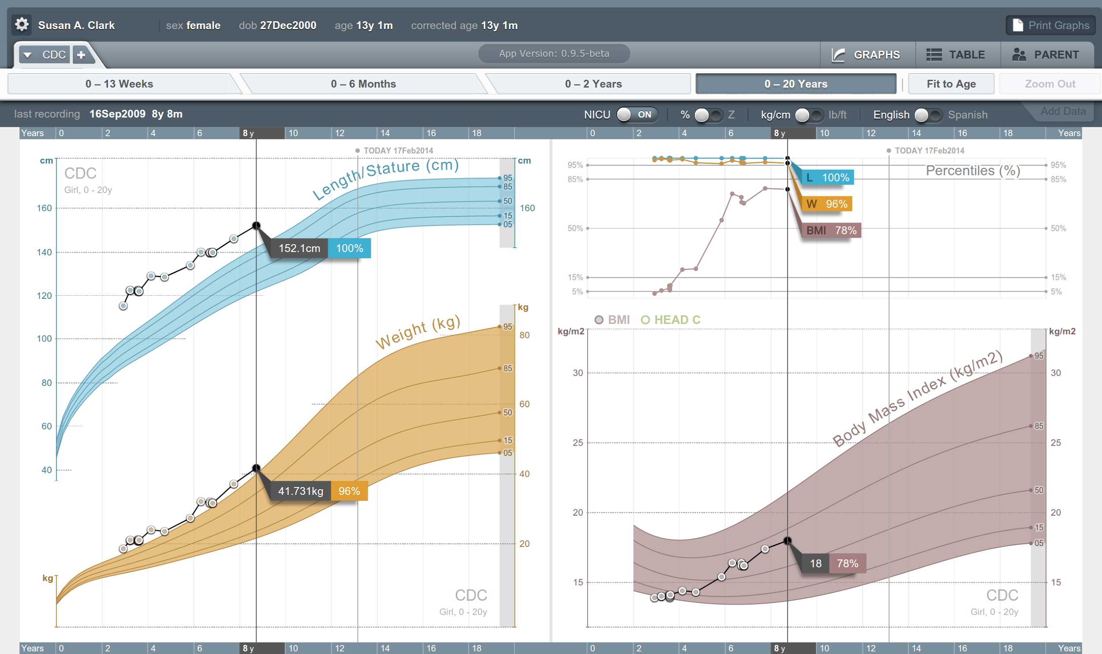


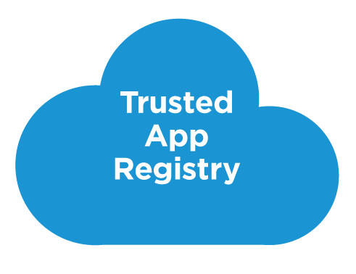



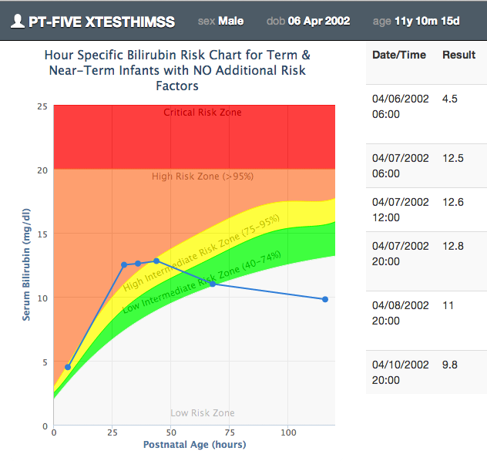







SMART on FHIR
Mobile Apps
Web Apps
OAuth2
REST API
MU-oriented FHIR Data Profiles
Underlying Health IT Systems
Your system here.

Slide 124
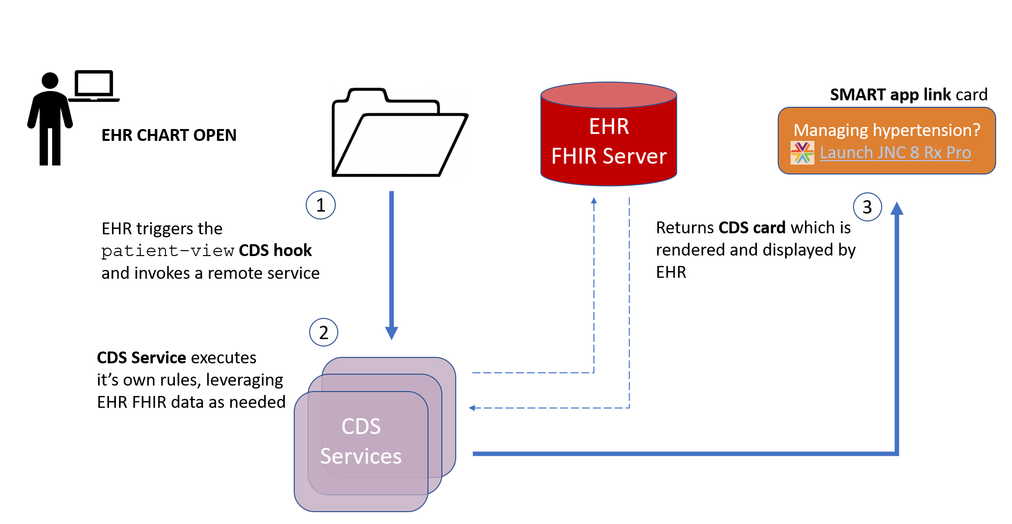
CDS Hooks

Slide 125
Review Tutorial Objectives
You should:
Know where FHIR fits in the broader healthcare landscape, including other HL7 specifications
Be able to explain what FHIR is to others in your organization, and what impact it might have
Be equipped to help your organization determine if, when, where and how you might use FHIR
Know how to approach the FHIR specification to find out what more you need to know
Be prepared for the more detailed tutorials
Be able to engage with the community
Notes:
I will be trying to use the FHIR specification throughout this tutorial. Try to tie the topic into the spec and where the information can be found. So slides such as the following will be interspersed into the discussion as cues to jump to spec…..
Come back to this at end to see if objectives have been met.

Slide 126
Thank You –
Questions?

